Slide 1


Slide 2
E-CLOTHING MART
GROUP MEMBERS
SHAHZAD BABAR 22-SE-087

Slide 3
INTRODUCTION
Online clothing store is a form of electronic commerce which allows consumers to directly buy garments from a seller over the Internet using a web browser or a mobile app. Consumers find a product of interest by visiting the website of the retailer directly or by searching among alternative vendors using a shopping search engine, which displays the same product's availability and pricing at different e-retailers.

Slide 4
CORE FUNCTIONALITIES
The core functionalities of an online clothing store are:
Product Categories
Product Catalogue
Cart
Transaction Handling

Slide 5
INTRODUCTION OF CHOOSEN TOOL
Figma is a collaborative web application for interface design, with additional offline features enabled by desktop applications for macOS and Windows. The feature set of Figma focuses on user interface and user experience design, with an emphasis on real-time collaboration, utilizing a variety of vector graphics editor and prototyping tools.

Slide 6
Justification of HCI Principles

Slide 7
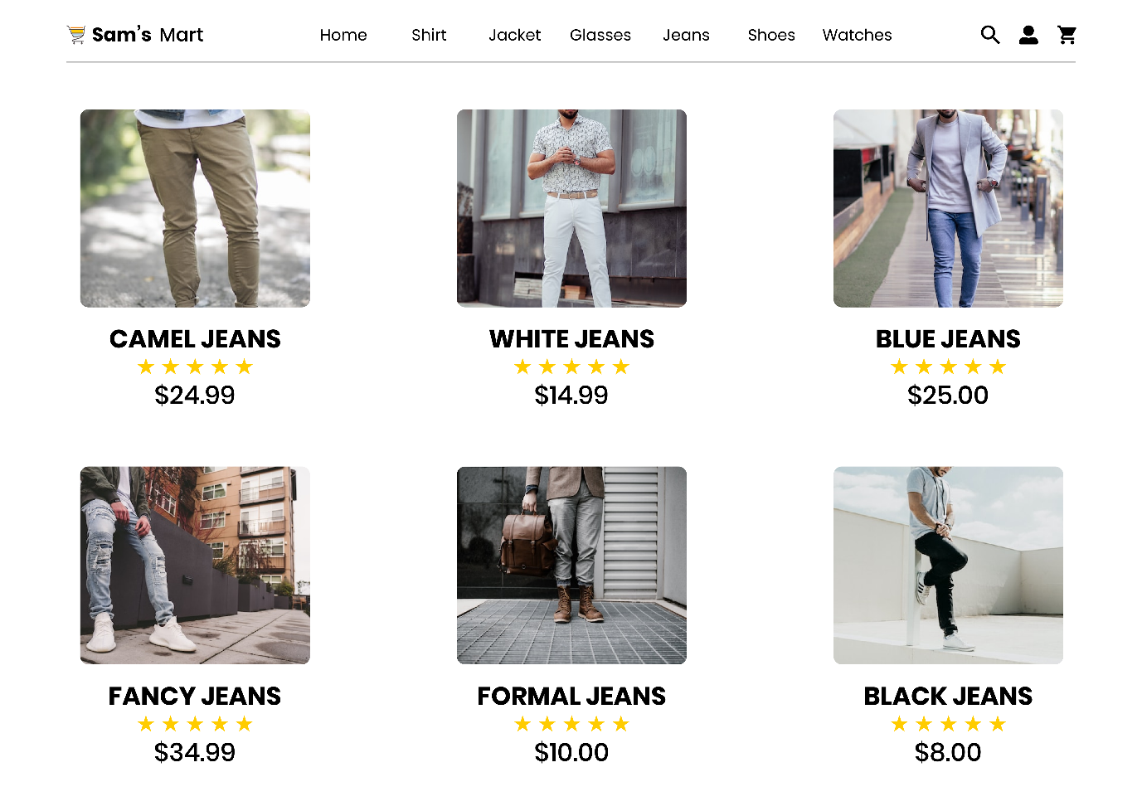
Visibility
Our user interface is really visible. He or she can view various button icons, color combinations, and menu alternatives without any reluctance on the part of the user. Additionally, the interface's typeface and alignment are considerably more prominent.

Slide 8
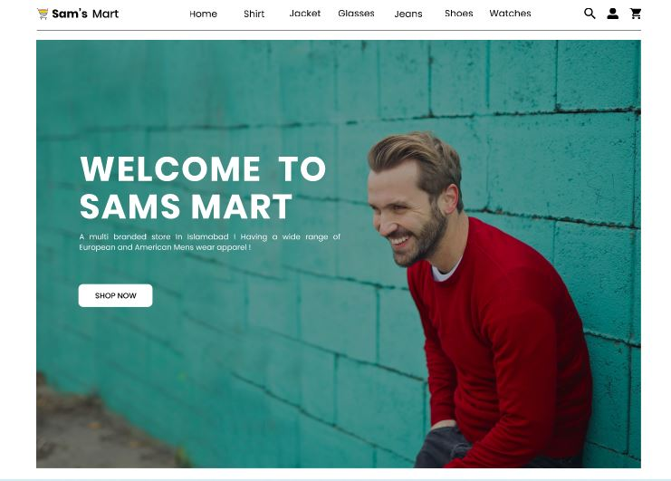
Simplicity
Our user interface is really simple as there is no vibrant colors are used. The interface have a very minimalist design which will attract the people more.

Slide 9
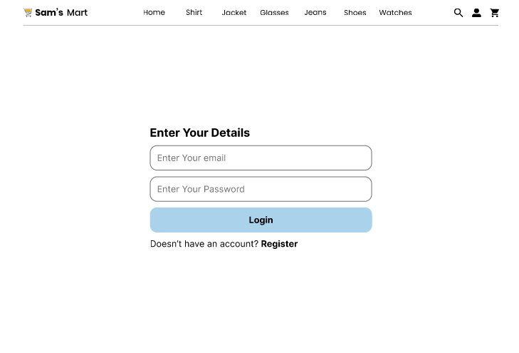
Error Tolerance
Our interface has the ability for error tolerance, so if a user takes an incorrect action, the system will deliver an error message, prompting the user to take the appropriate action. In login, if user enter wrong username or password, then system shows error message that the particular information is invalid.

Slide 10
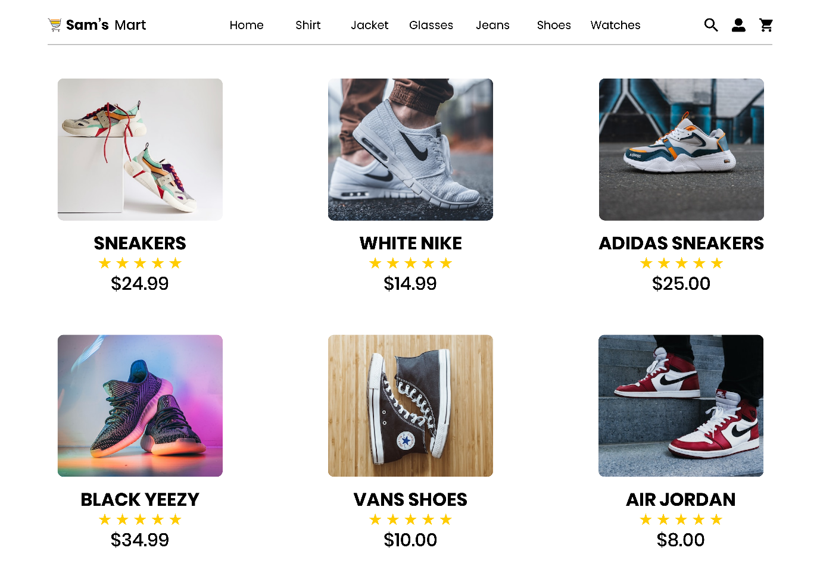
Learnability
The interface that we have designed is itself learnable every single entity is separately mentioned and there is no double meaning words or images which will make the user in doubt.

Slide 11
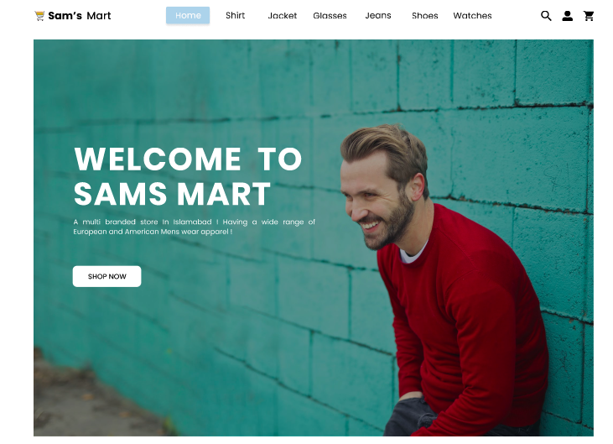
Feedback
The program meets the feedback user interface principle; in response to a user action, the system provides feedback, allowing the user to confirm that the action was carried out. As an example, in the menu, if the user points on any button it will perform a hovering effect and change its color.

Slide 12
DESIGN SCREENSHOTS

Slide 13
LANDING PAGE

Slide 14


Slide 15
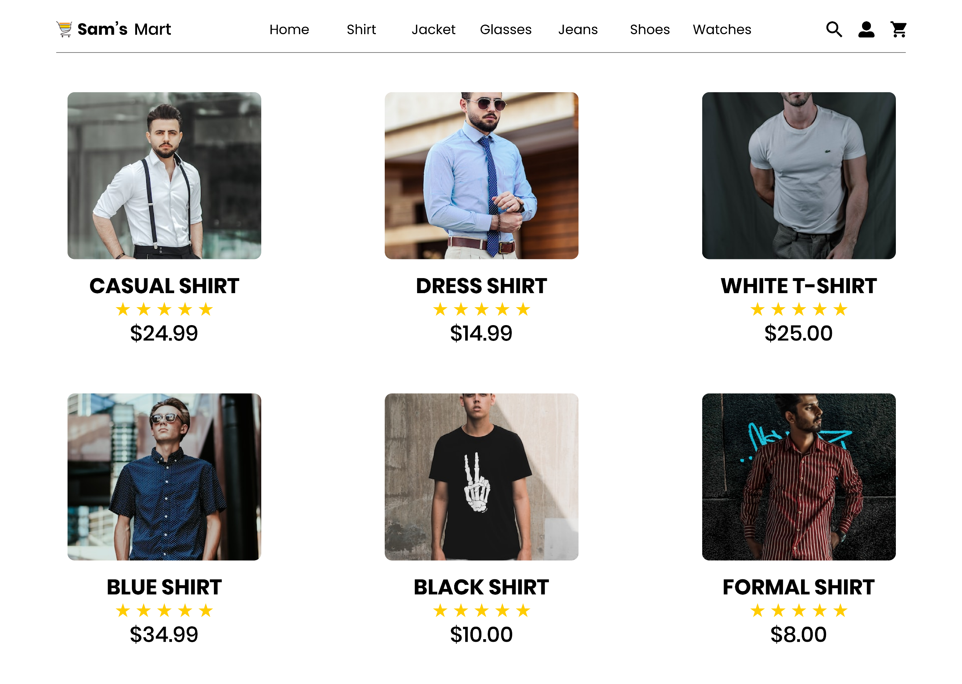
SHIRTS

Slide 16
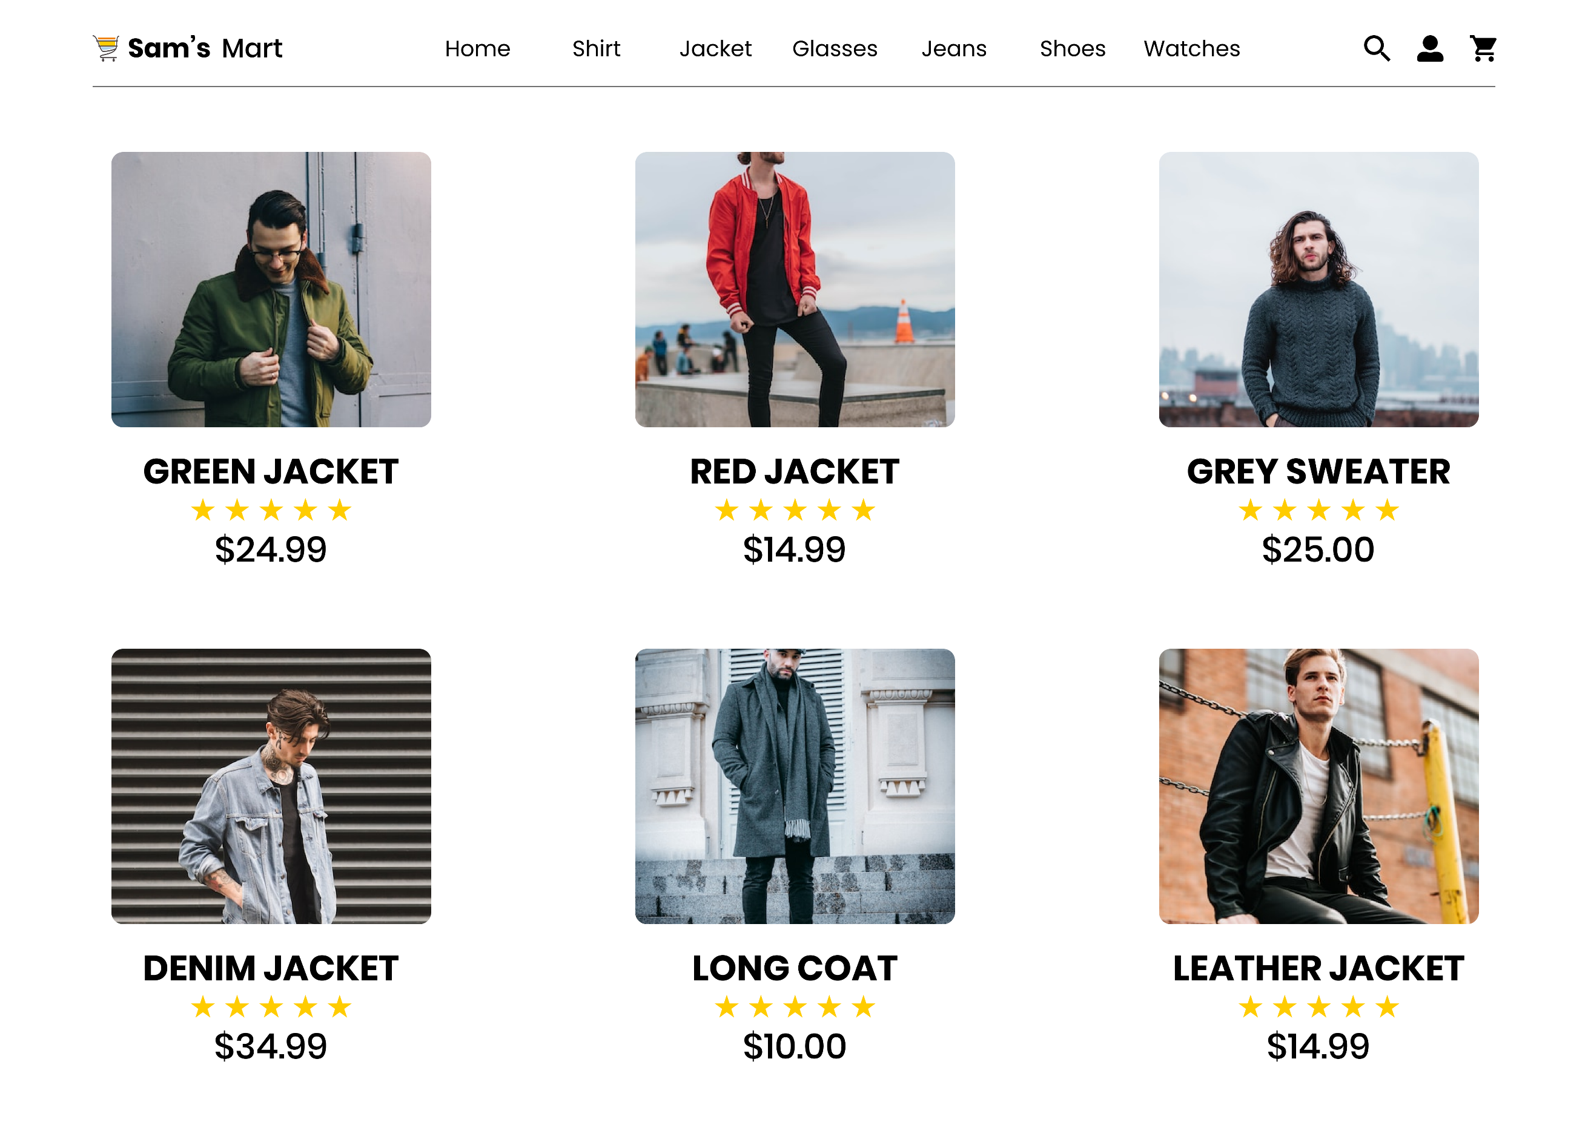
JACKETS

Slide 17

JEANS

Slide 18
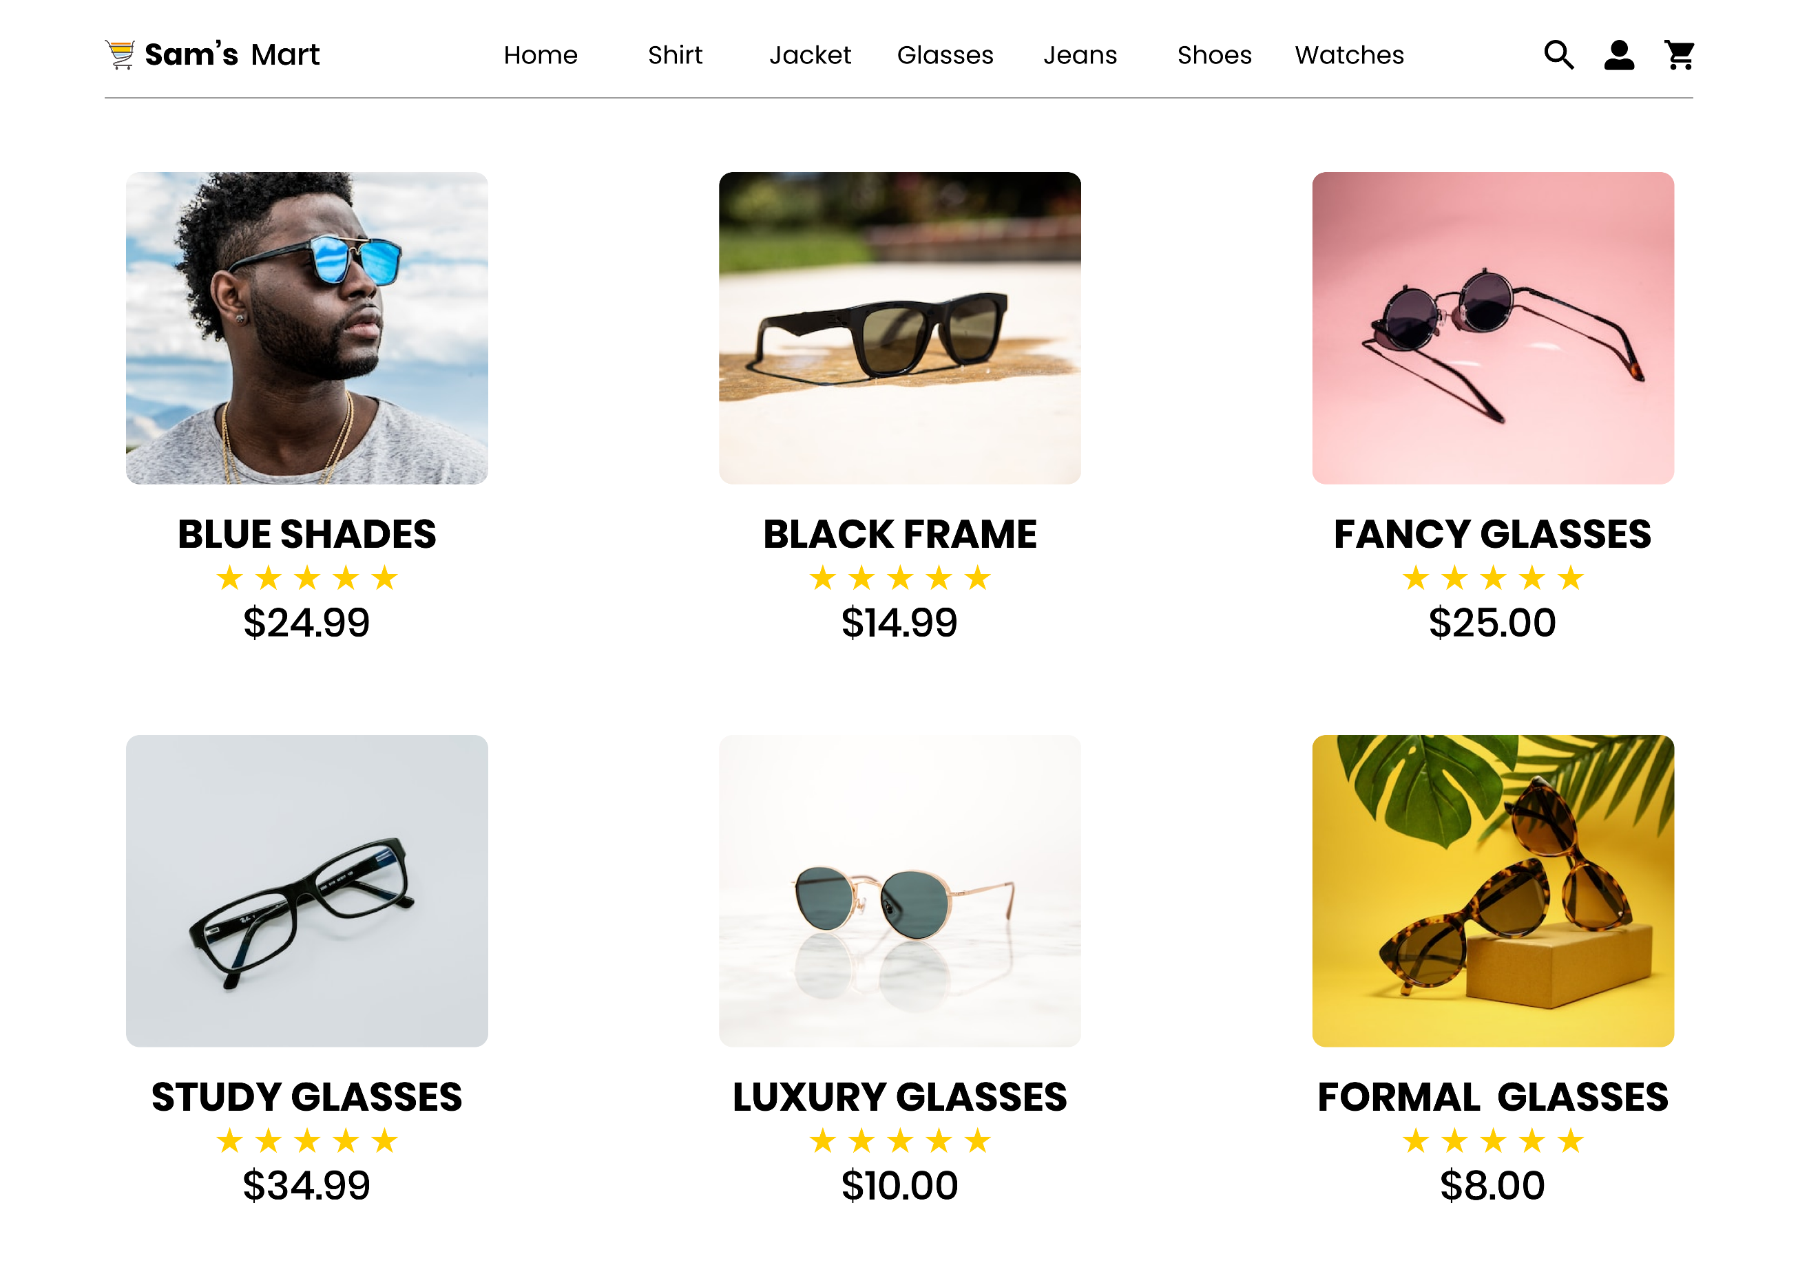
GLASSES

Slide 19

SHOES

Slide 20
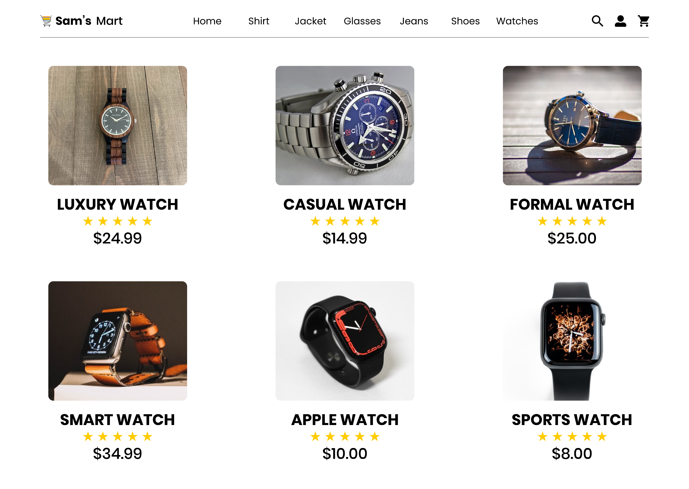
WATCHES

Slide 21
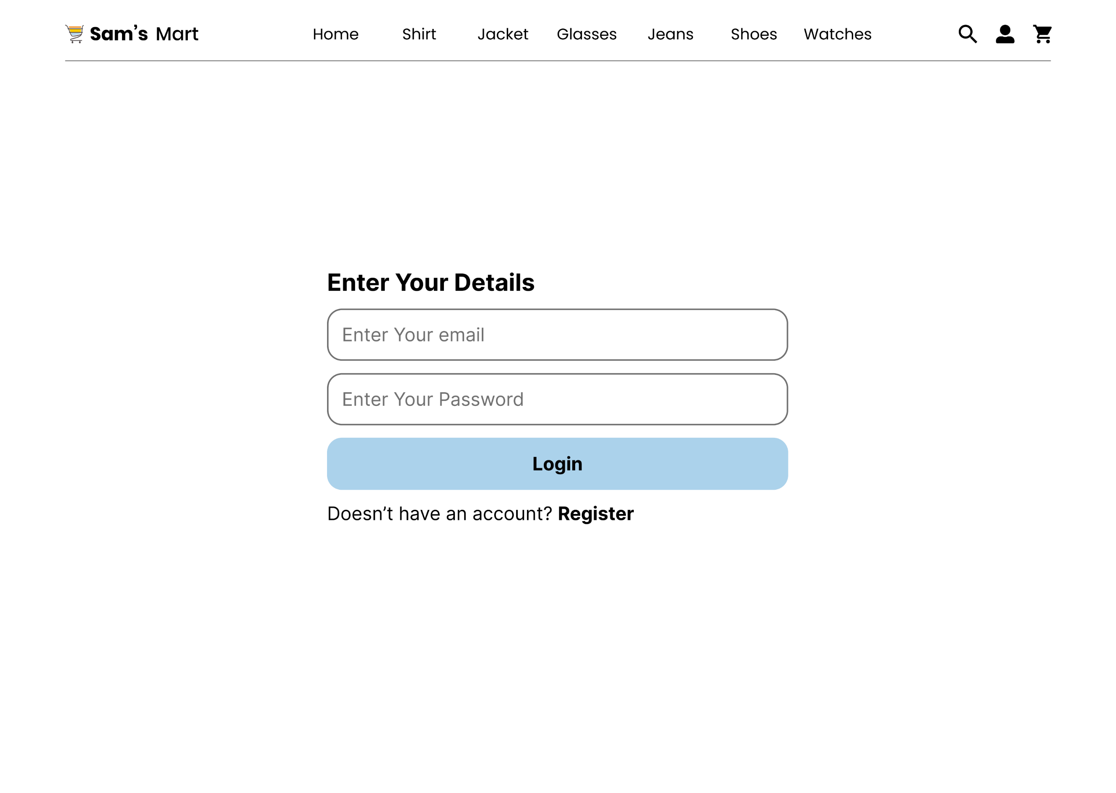
LOGIN

Slide 22
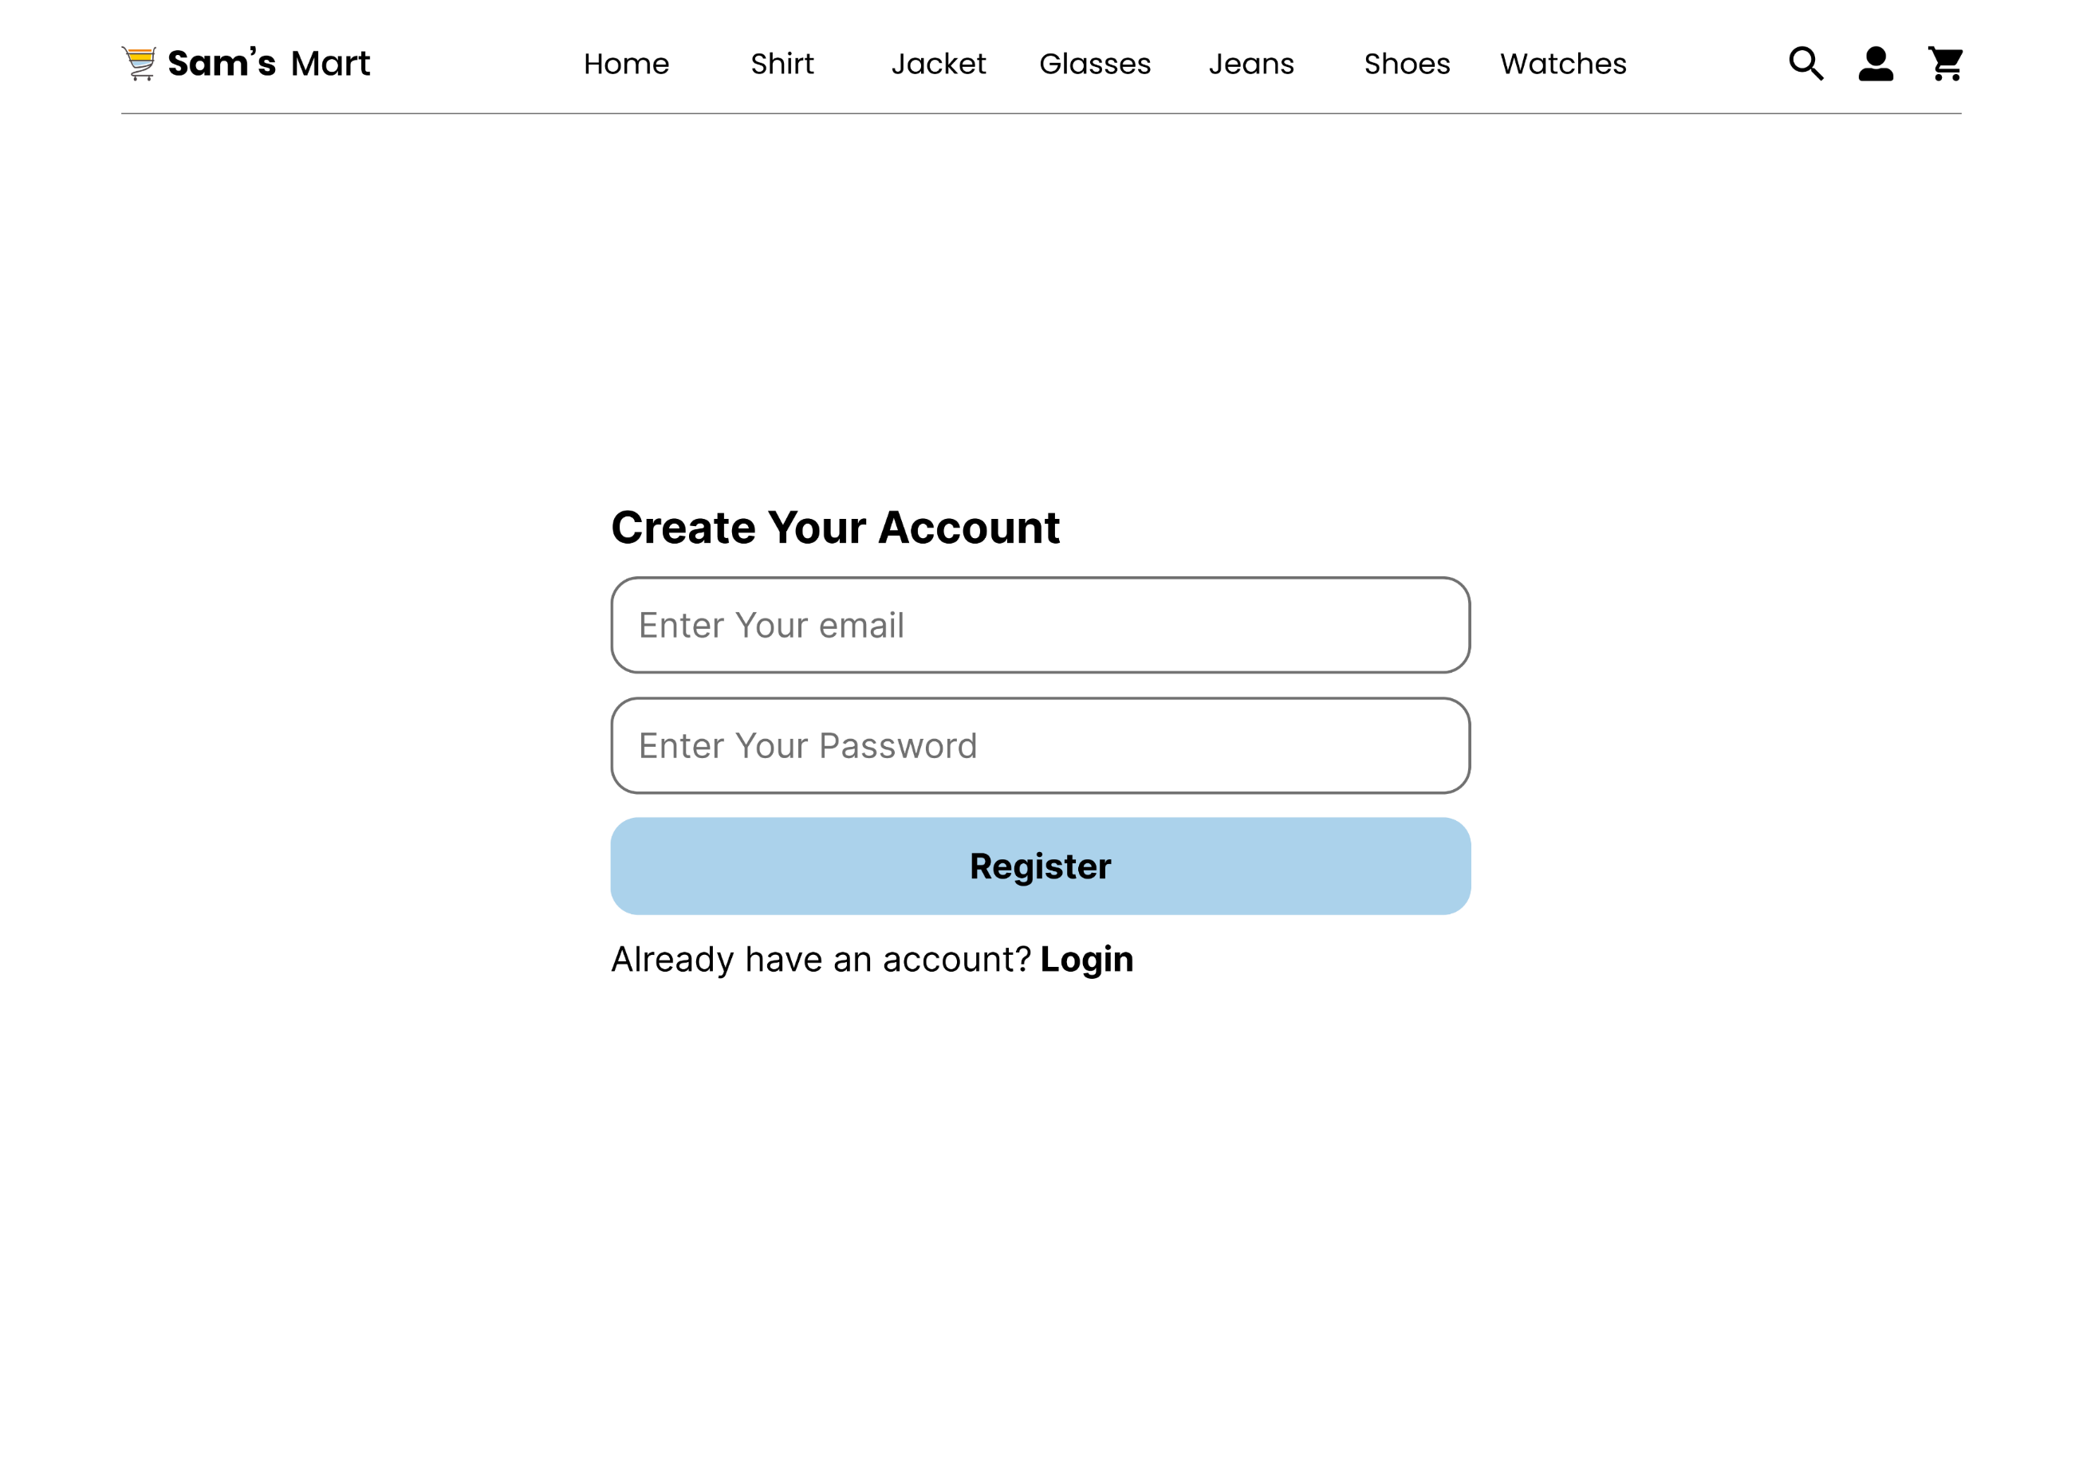
REGISTER

Slide 23
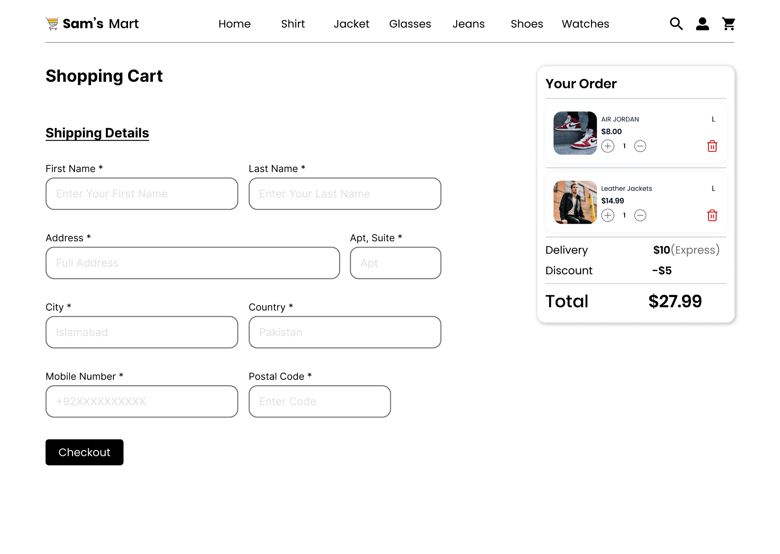
CART

Slide 24
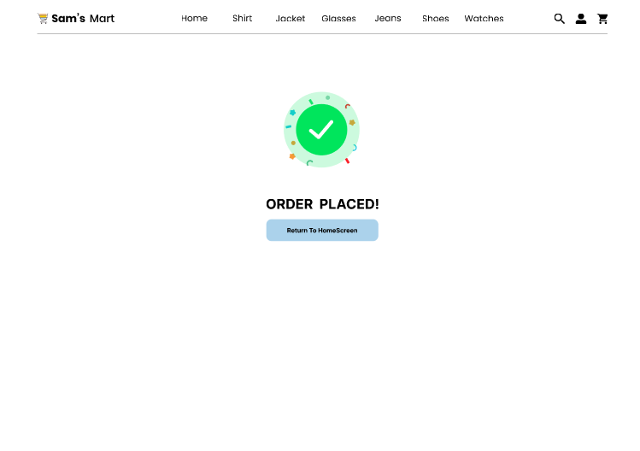
CHECKOUT

Slide 25
APP VIEW

Slide 26
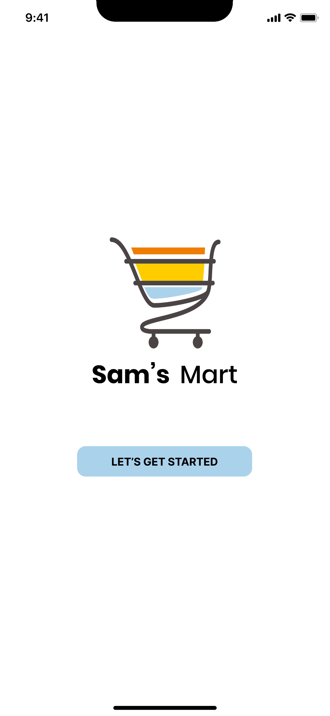
STARTUP

Slide 27
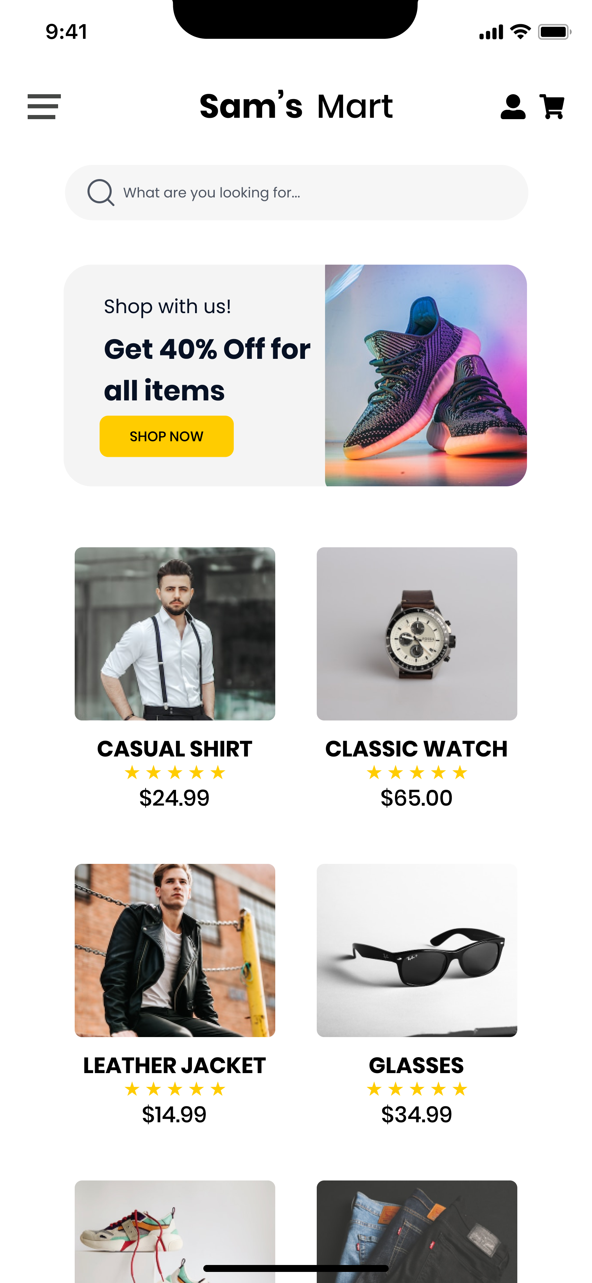
LANDING PAGE

Slide 28
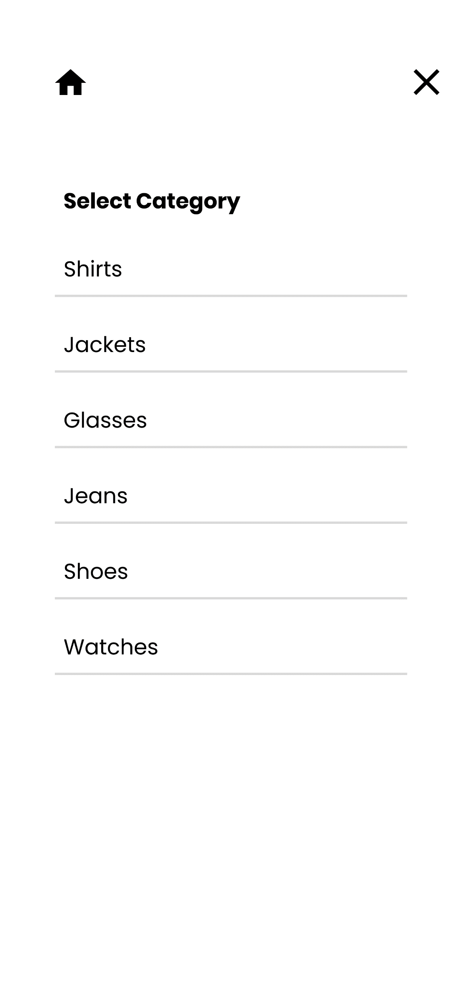
SIDEBAR

Slide 29
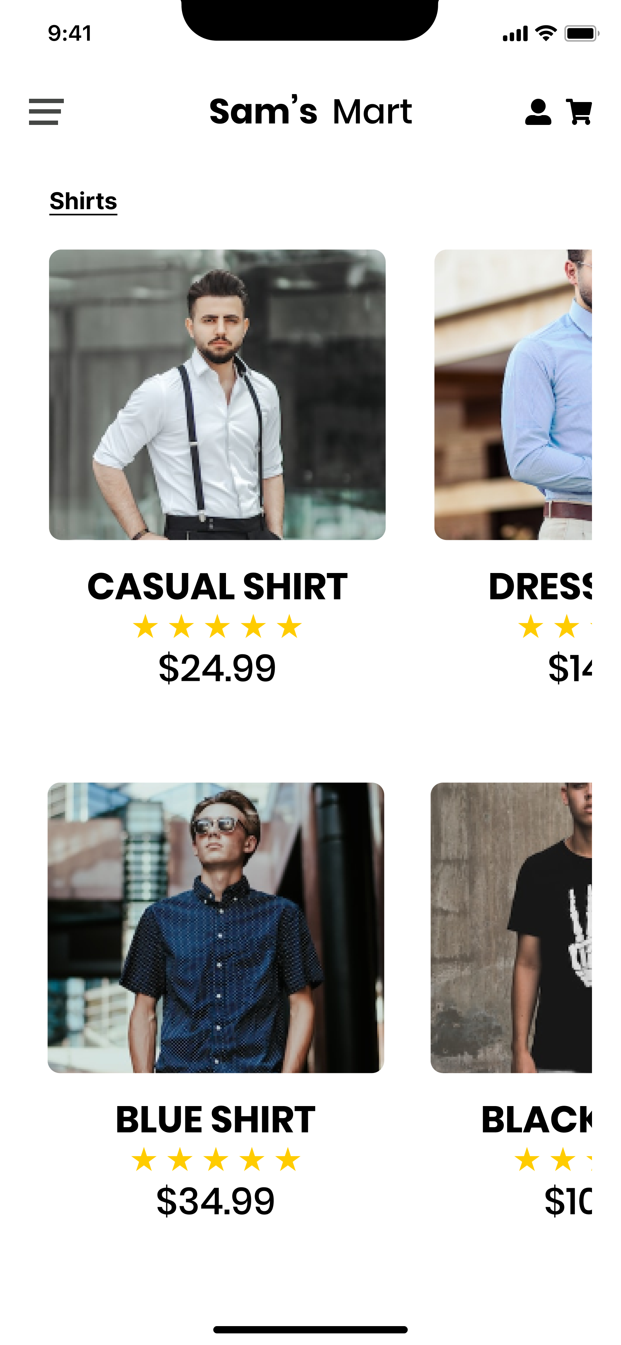
SHIRTS

Slide 30
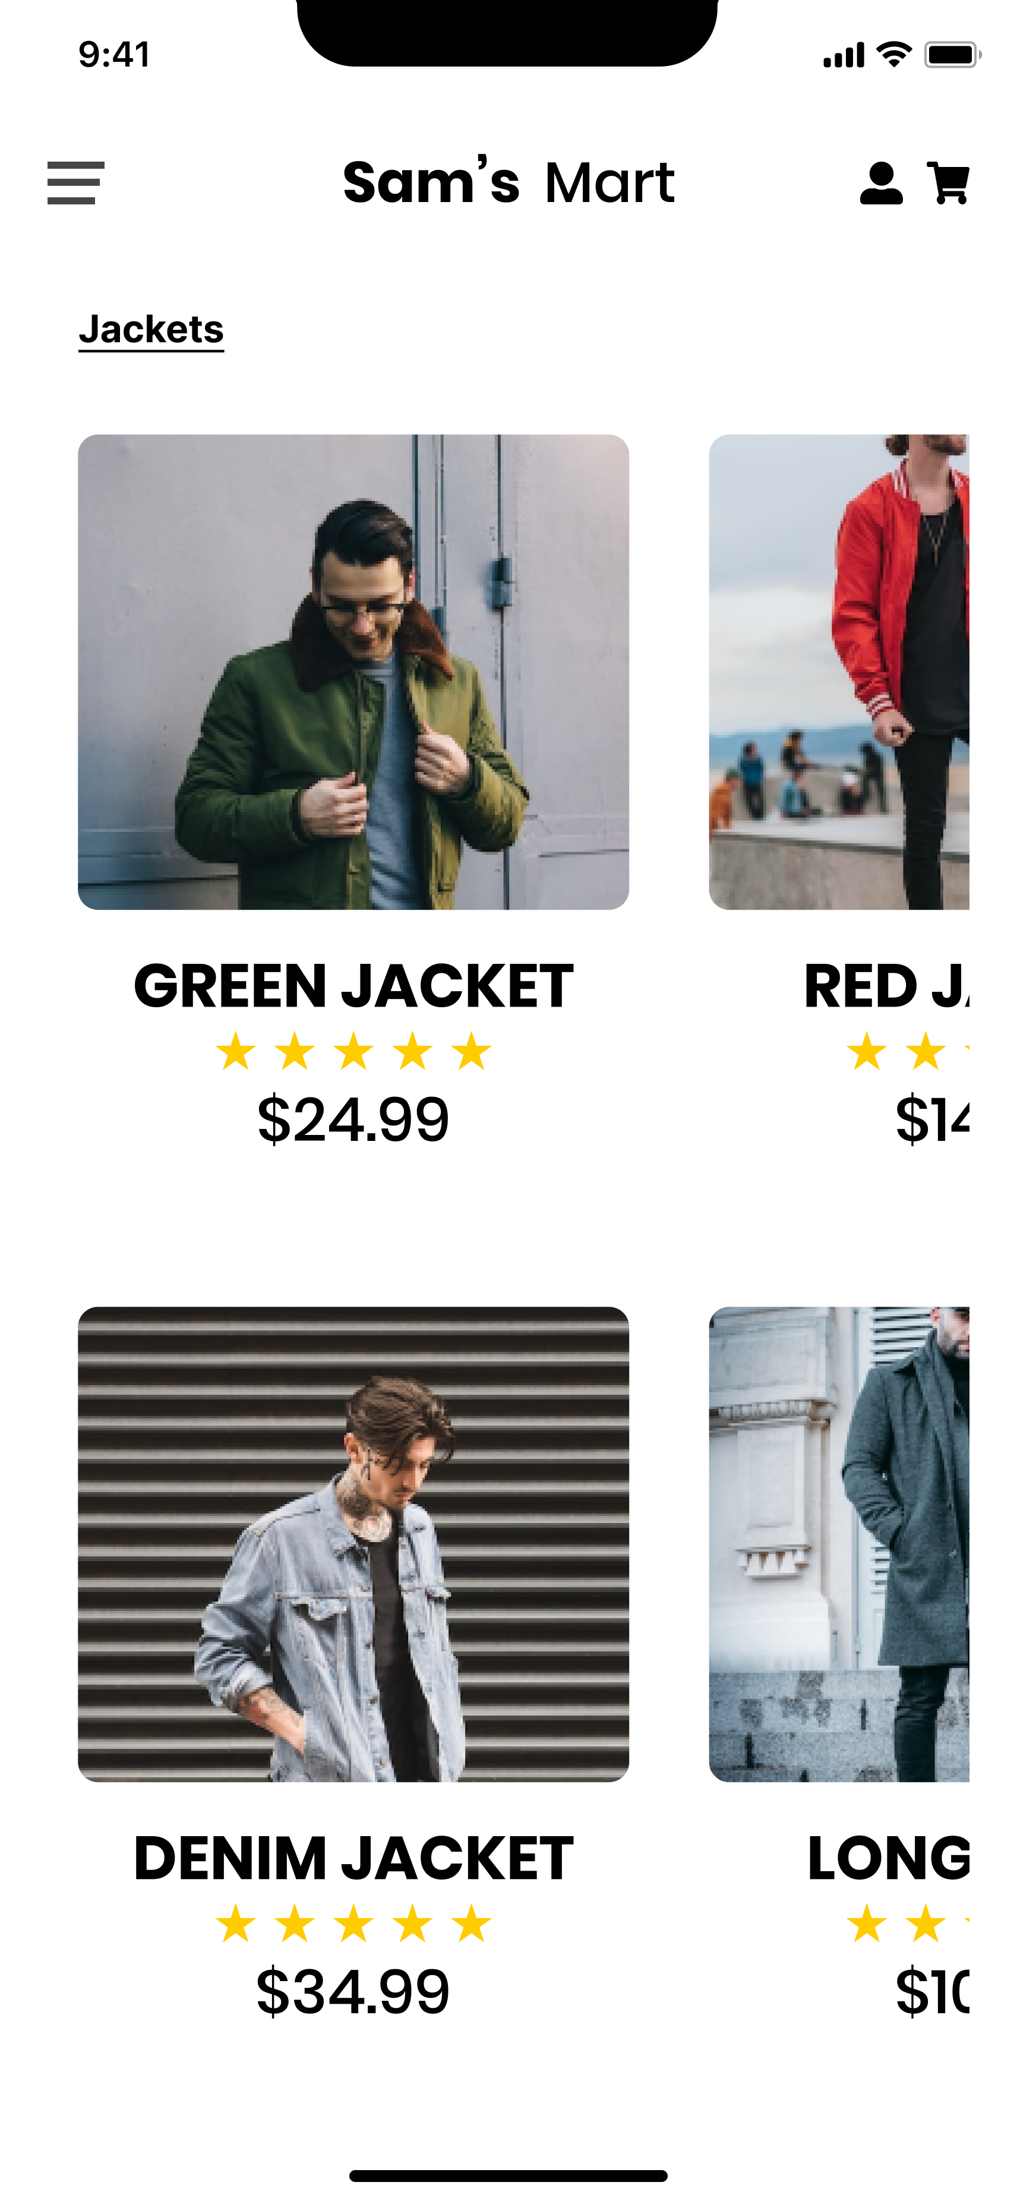
JACKETS

Slide 31
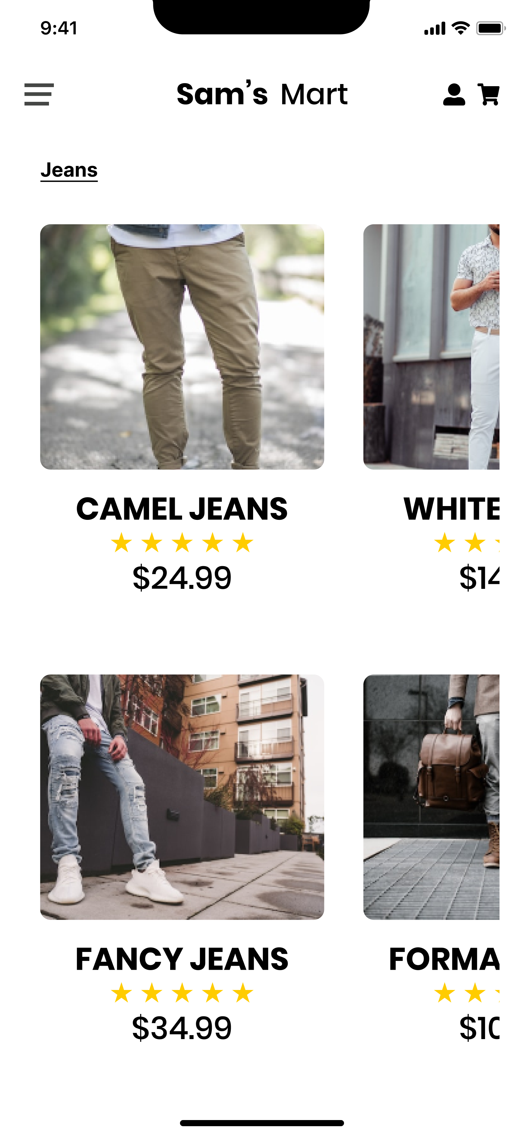
JEANS

Slide 32

GLASSES

Slide 33
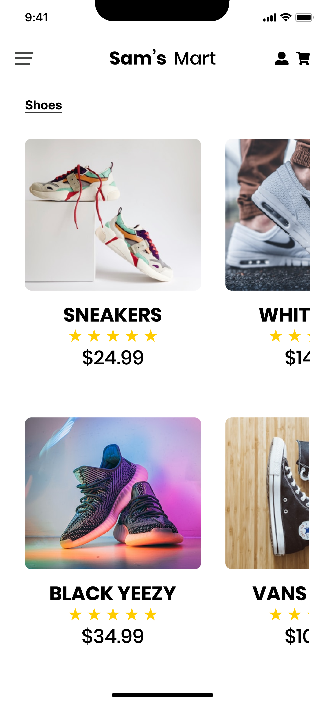
SHOES

Slide 34
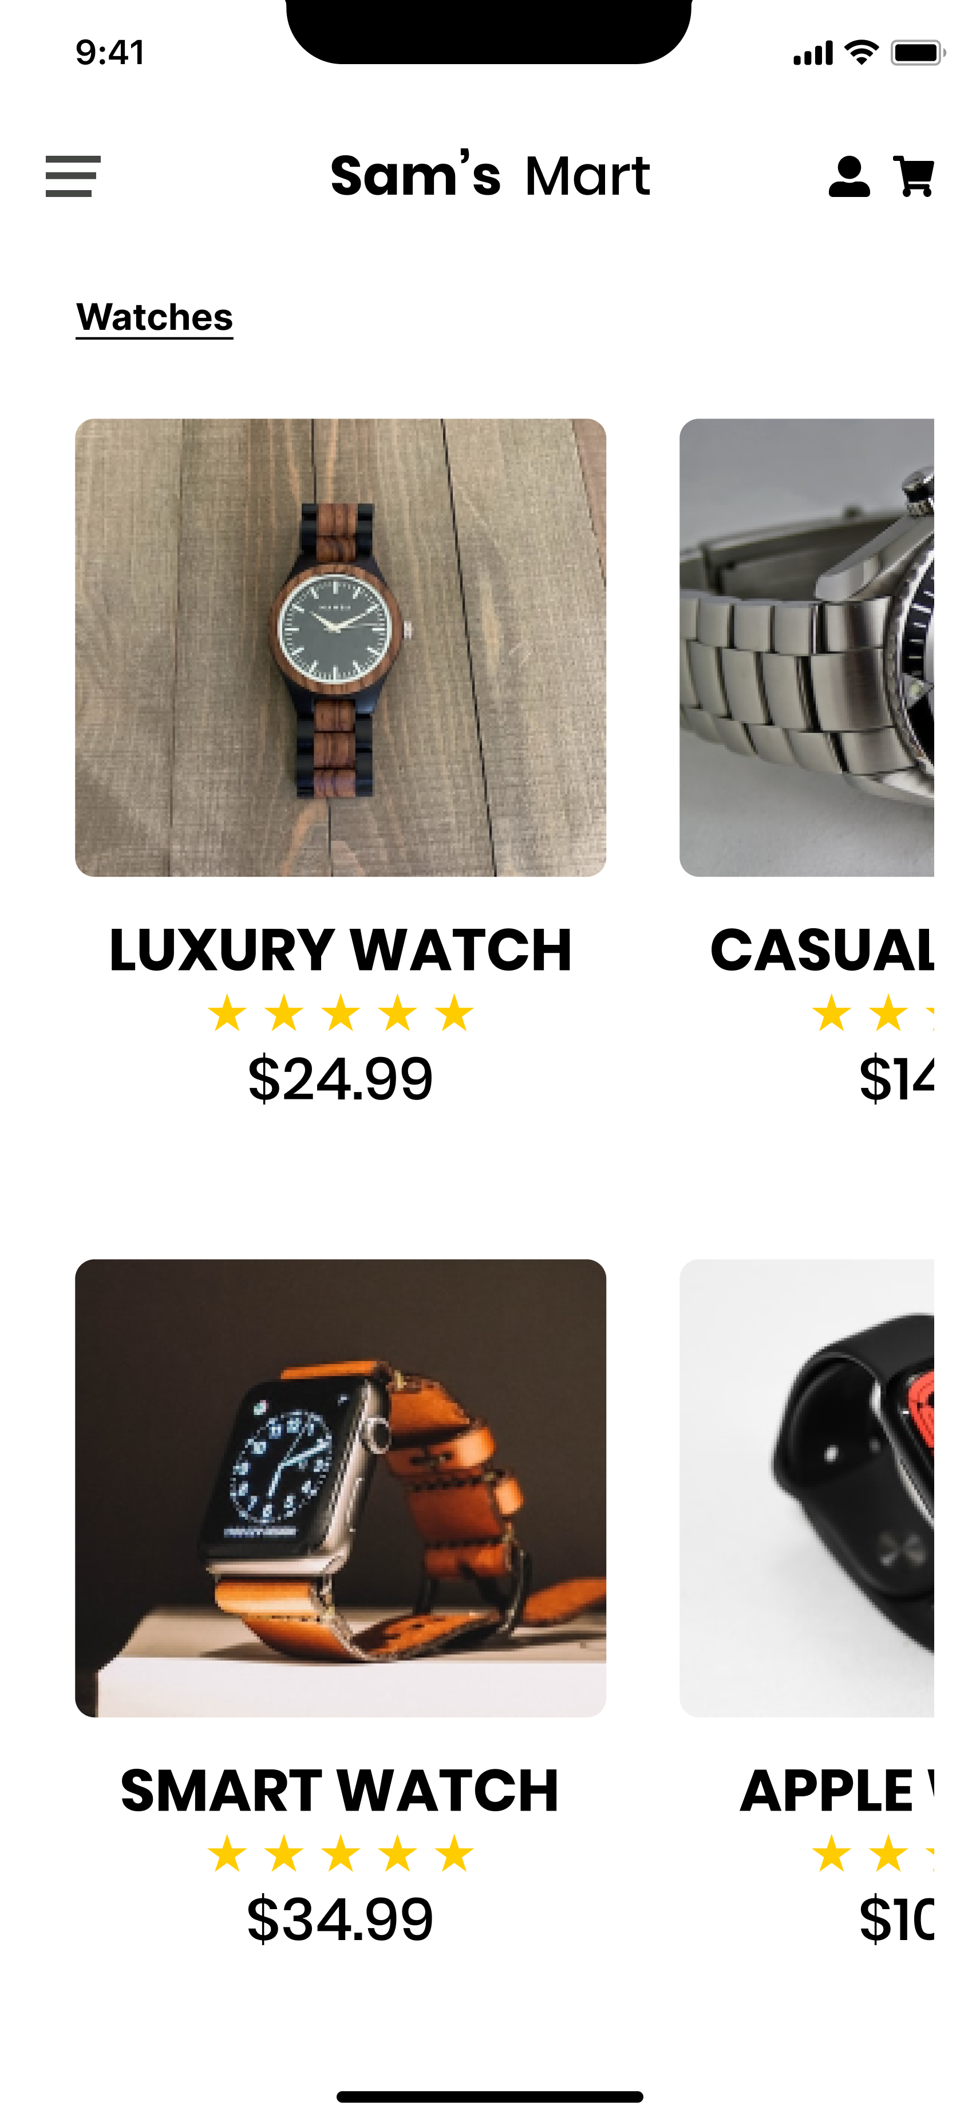
WATCHES

Slide 35
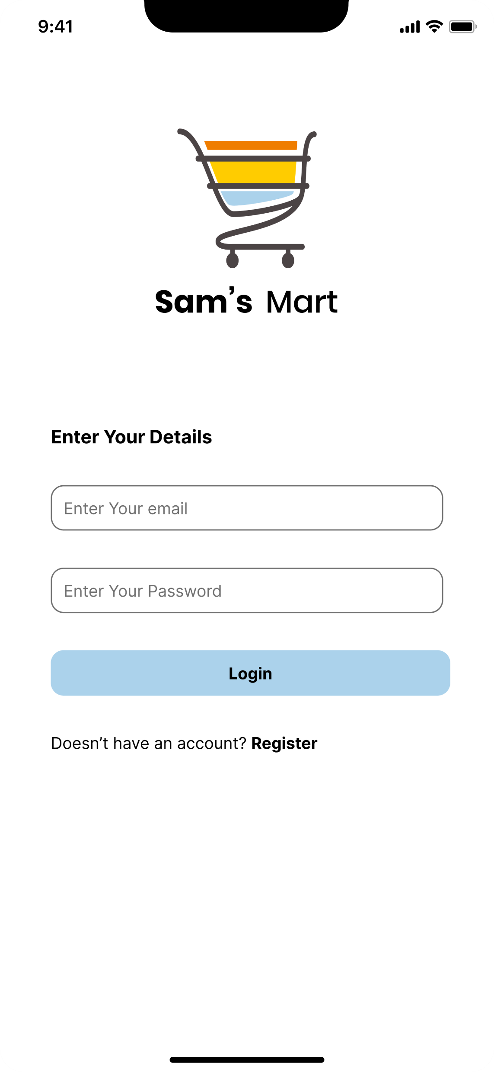
LOGIN

Slide 36
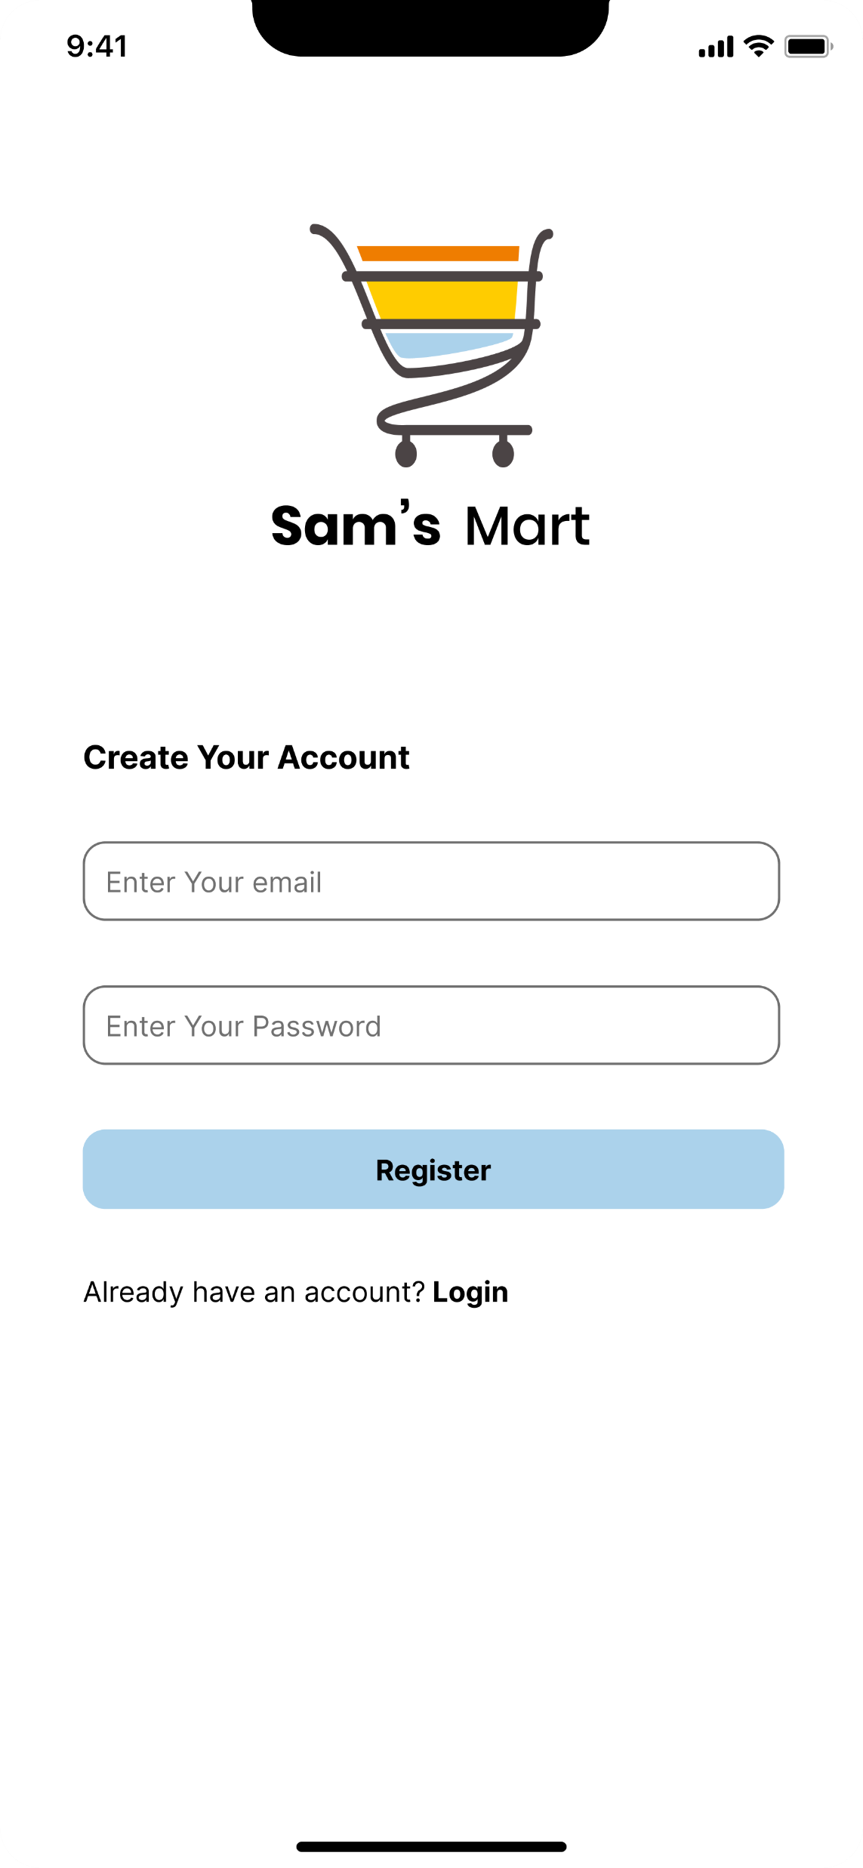
REGISTER

Slide 37
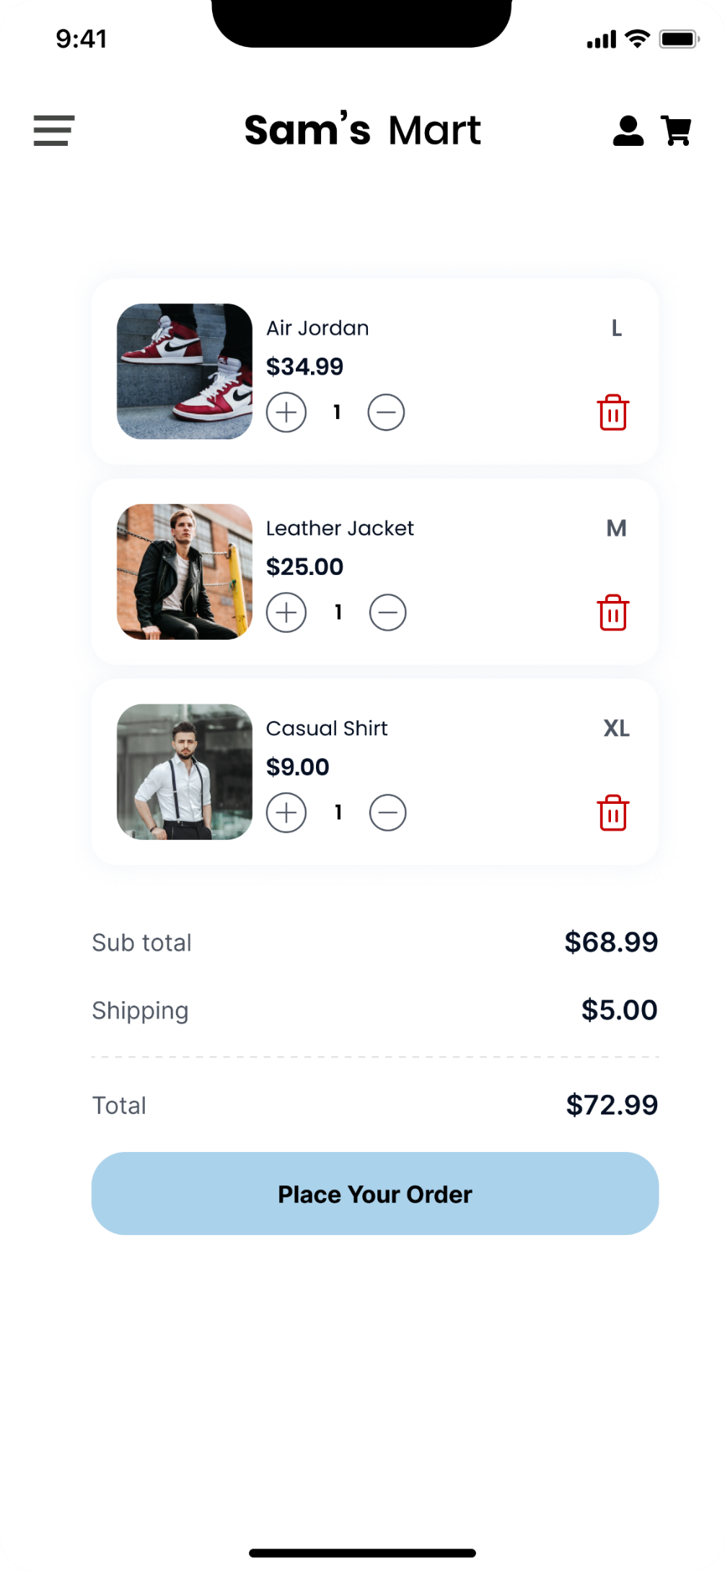
CART

Slide 38
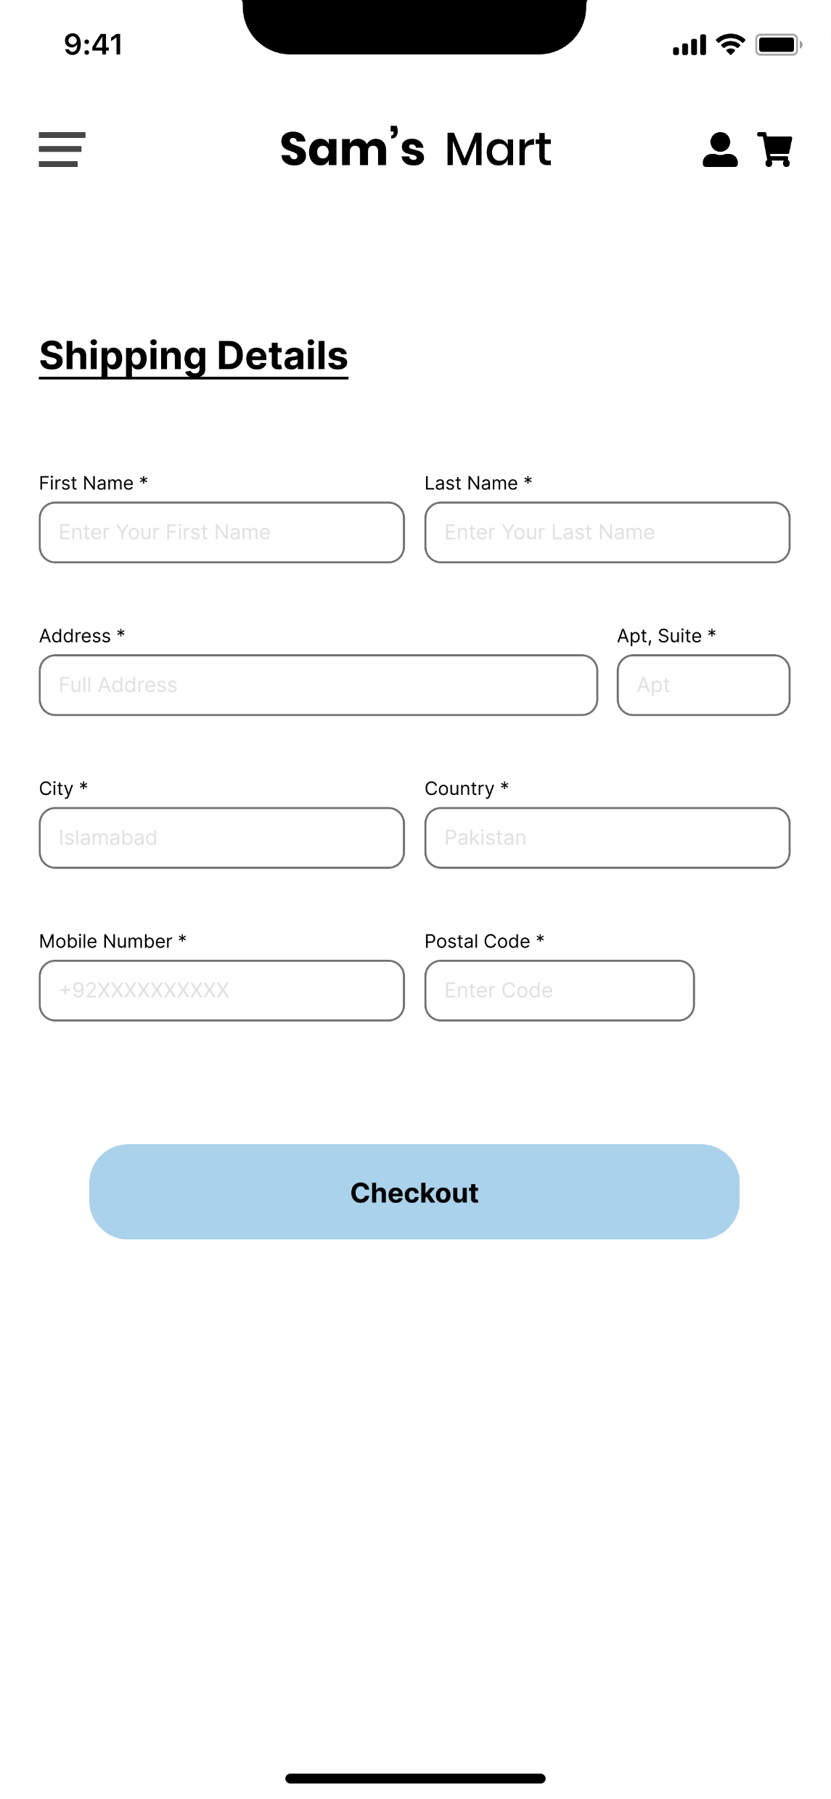
DETAILS

Slide 39
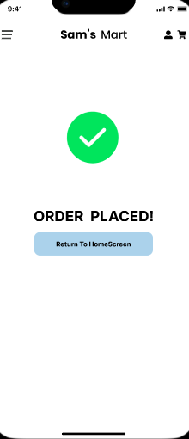
CHECKOUT

Slide 40
THANKYOU!
Any questions?

